Slide 1
Predicting Patient Length of stay

Slide 2
Agenda
Introduce Business Case
Data Exploration
Data Cleaning and Feature Selection
Model Description
Conclusion

Slide 3
Predicting Patient “Length of stay” at a hospital can help hospitals provide best care for the patients while optimizing their efficiency
Improve Patient Care
Improve Hospital efficiency
Better schedule doctor visits to ensure right care at the right time
Help with better communication with patient and their family on expected stay in hospital
Plan for availability of facilities like type of hospital rooms, labs etc. and services such as diagnostic tests, physical exercise, stress management etc.
Optimize availability and scheduling of doctor visits
Optimize allocation of resources such as beds, labs, medical equipment etc.
Optimize patient costs
Reduce costs for patients by predicting requirements along the stay

Slide 4



Use Case : Improving Patient care
Knowing a critical patient who is going to stay for 8 days, the hospital can plan for the same expert doctor to be available for regular checks for the entire stay to ensure best care and continuity
Better scheduling
Better communication
Communicating approximate duration that the patient is going to be in the hospital helps ease anxiety for the patient and family and also plan their life and care of patient better
Better planning
A frail cancer patient who will be staying in the hospital longer with frequent need of various facilities such as testing, surgery room, radiation etc. on certain days and can help plan for availability better

Slide 5


Use Case : Improving Hospital efficiency
Predicting length of stay of each patient can help understand need for time from expert doctors whose time is very valuable and prioritize availability for patients requiring urgent care
Optimize scheduling
Optimize resource allocation
Knowing the number of patients and their expected stay will help identify what resources to allocate to which patient and when and help take care of more patients with same amount of resources
Knowing the duration of stay and level of care needed, patient can be moved to lesser expensive type of care and facility to optimize costs for the patient
Optimize costs

Slide 6
Data Description
Raw Data
Data Source
34 variables and
1,048,576 records
https://health.data.ny.gov/Health/Hospital-Inpatient-Discharges-SPARCS-De-Identified/82xm-y6g8
Data Split
Target Variable
Training and test data: 70% training set and 30% test set
‘Long Stay’ is classified as:
Length of stay > 3 days = Long
Length of stay < 3 days = Short

Slide 7
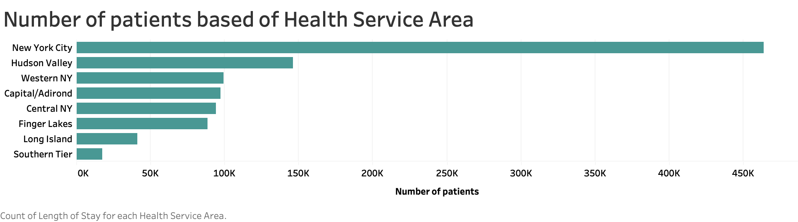
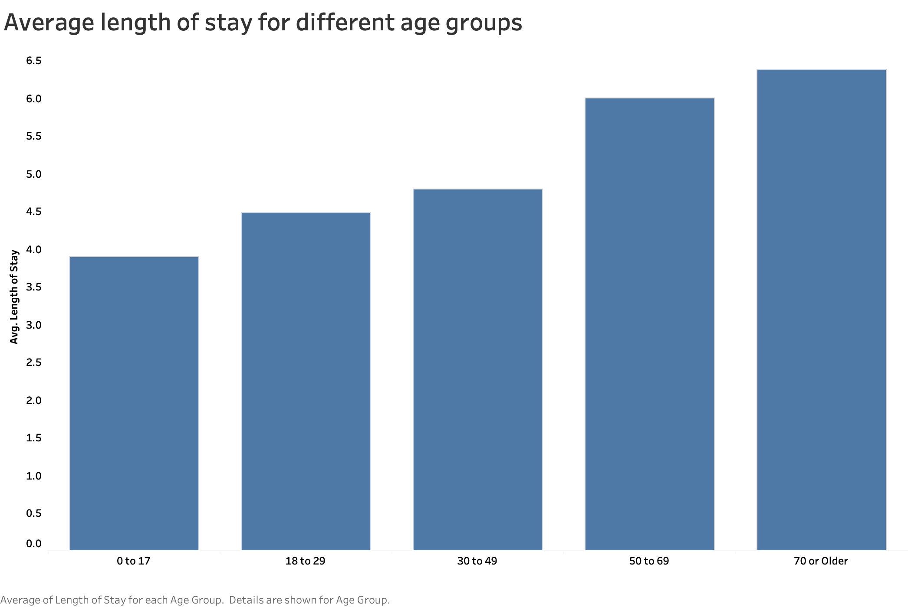
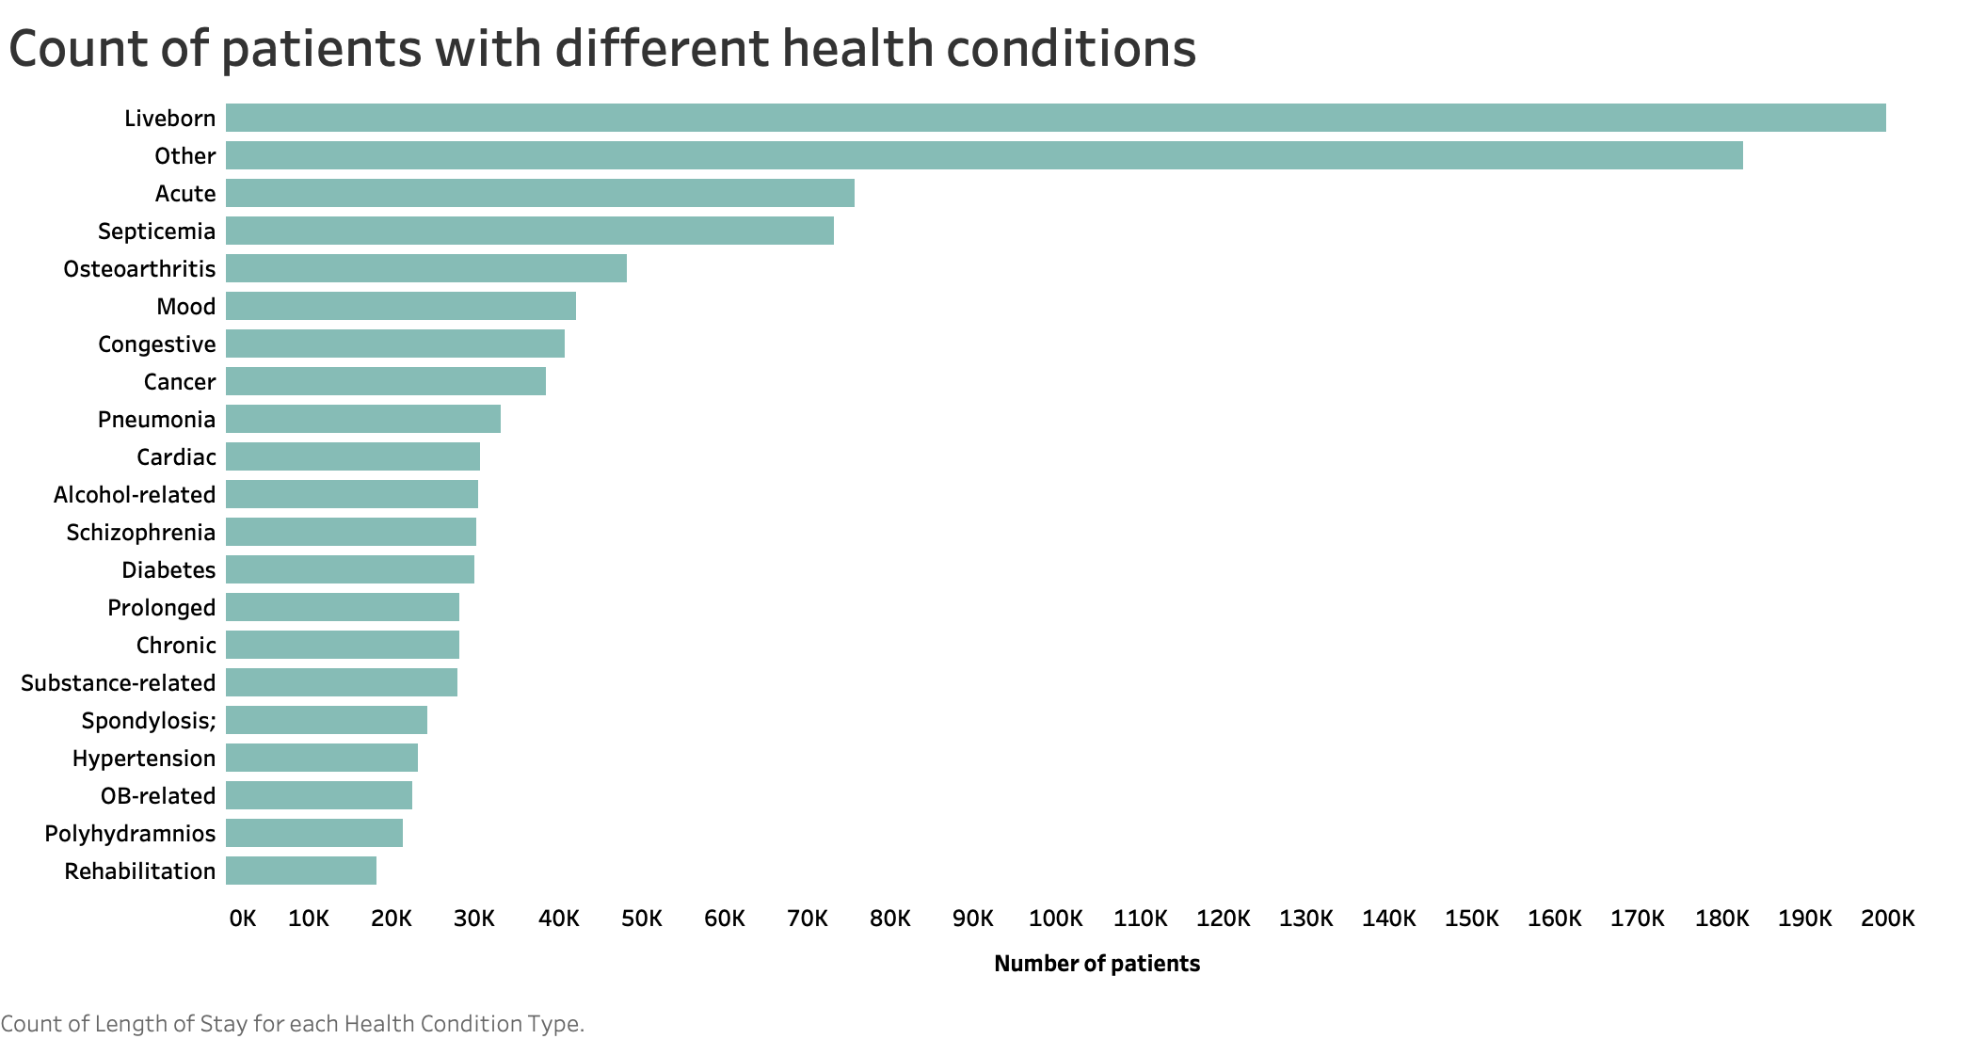
Exploratory Analysis

Slide 8
Data Cleaning and Feature Selection
There were features for every record and not all are important for our analysis. So, some features were eliminated based on domain knowledge and intuition
Variables with high correlation were removed: This was done to remove redundant variables and improve data accuracy
Variables related to diagnosis code, drug description, cost, payment methods, and insurance were removed as the idea is to predict a patient’s long stay at the time of admission
The “Health Condition” column was extracted from the “Disease long description” column. The purpose of this step is to extract the disease name and make a more focused column that can represent the disease concisely and make it easier to use in the model
The dataset was sorted by most commonly occurring diseases and 10 diseases were selected for further analysis
Variables used: Age Group, Health Service Area, Gender, Race, Ethnicity, Health Condition, and Admission Type

Slide 9
Data Mining Results
Method | Accuracy | Precision | Recall | False Positive Rate
Linear Regression | 0.77 | 0.66 | 0.58 | 0.14
Logistic Regression | 0.76 | 0.71 | 0.71 | 0.2
Naive Bayes | 0.72 | 0.72 | 0.76 | 0.32
Boosting | 0.71 | 0.67 | 0.86 | 0.45

Slide 11
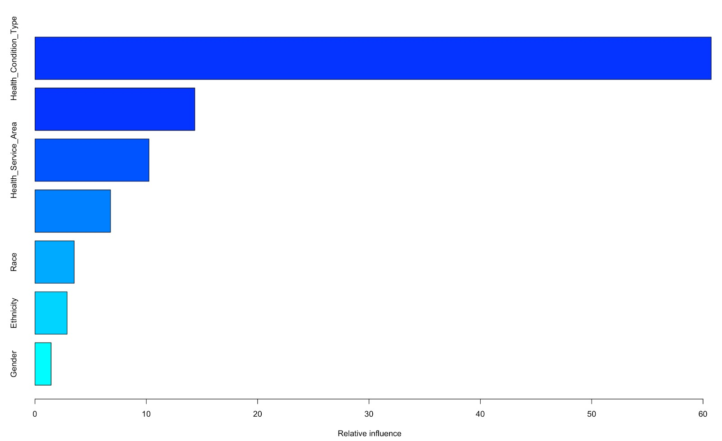
Best Model
The Best Model is Classification Tree-Boosting
Achieved the Highest Recall of 86%
Precision of 67%
Optimal Cut-off at 0.4
Variable Relative Influence
Actual Predicted | Short Stay | Long Stay
Short Stay | 18,766 | 15,395
Long Stay | 4,974 | 31,666
Best Solution is Boosting with 86 % recall

Slide 12
Conclusion
This model can be beneficial to hospitals and patients alike. Hospitals will be able to predict long-stay patients with 86% accuracy which will help them plan their resources better than the current state.
Even in the cases where the prediction isn’t accurate, we have ensured the model output in such a way that patient inconvenience is very low. Our priority is to reduce anxiety and stress as much as possible for the patient and their family.
We believe this model has the potential to make a significant impact on the healthcare system.

